Slide 1
Chapter 2
Instructions:
Language of the Computer
Chapter 2_4 ppt

Slide 2
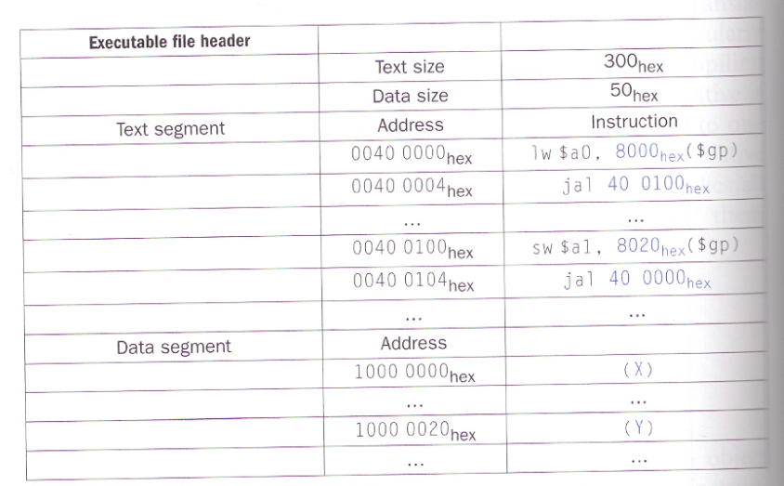
MIPS Registers

Slide 3
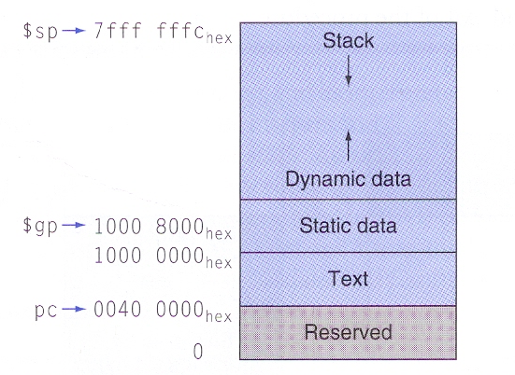
Memory and Pointers

Slide 4
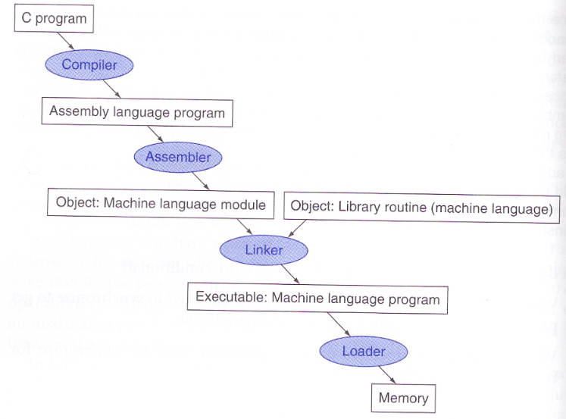
Program translation

Slide 5
Linker
Place code and data modules symbolically in memory
Determine the addresses of data and instruction labels
Patch both the internal and external references

Slide 6
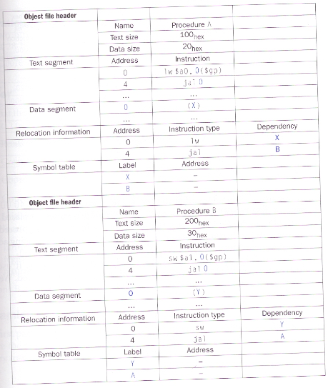
Linker example

Slide 7
Linker example (answer)

Slide 8
Dynamically linked libraries (DLL)
Drawbacks for statically linked libraries
  The library routines become part of the executable code. (it will not use the new version of libraries.)
  It loads all routines in the library (some routines will never be used)

Slide 9
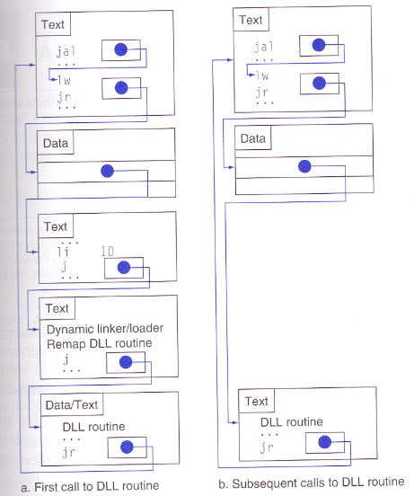
DDL (lazy procedure linkage)

